Slide 1
Historic Huntsville Preservation Commission Administrative practices
Katie Stamps
Historic Preservationist
City of Huntsville, Alabama

Slide 2
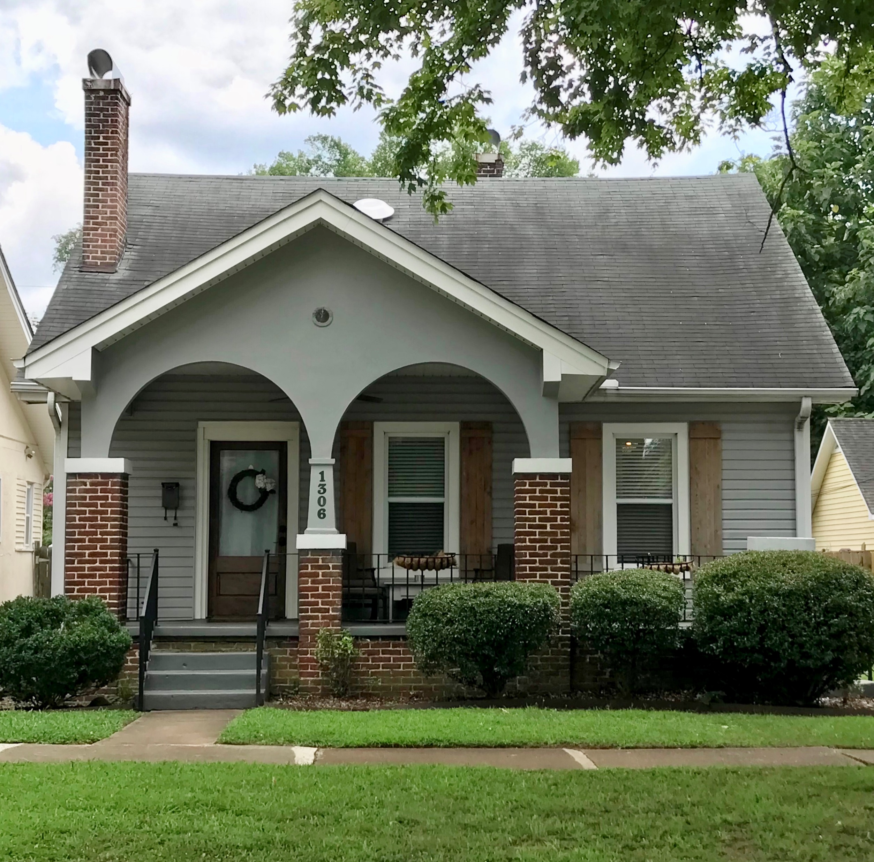
COA Application Process
Applications are due on the last Monday of each month
Applications can be submitted online, by email or in person
Application Fee $15
Required Attachments (if applicable)
Photographs
Measured Drawings
Site Plan
Material Specifications
Colors
Notes:
c. 1936 Bungalow
Five Points

Slide 5
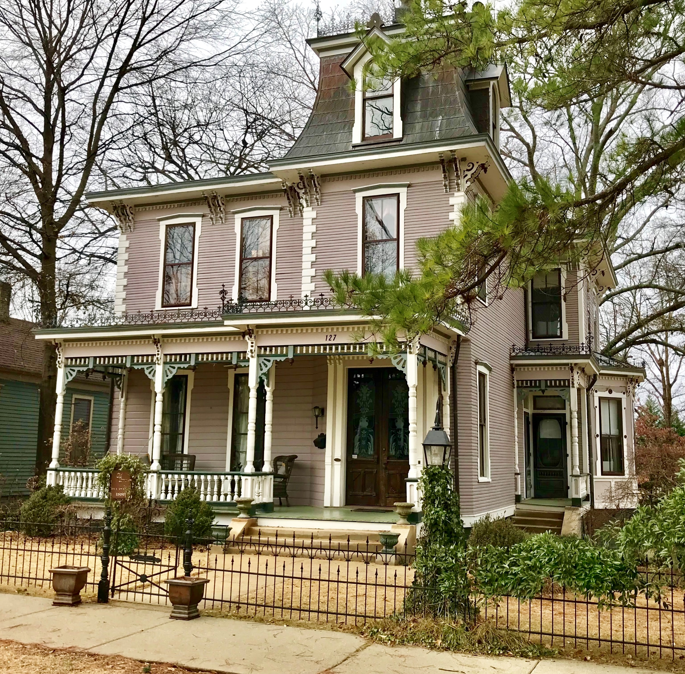
Staff comments
The following documents are sent to HHPC members for their review one week prior to each meeting:
Voting Agenda
COA Application Packet PDF
Application Forms
Drawings
Photographs
Materials/Colors
Staff Comments
Minutes from previous meeting
Notes:
1889 Second Empire, Italianate & Victorian
Old Town

Slide 7
Meeting Agenda
HHPC meetings are held on the second Monday of each month
Agenda
Preamble
Presentation of Applications
Discussion
Vote
Approval of Minutes
Other Business

Slide 8
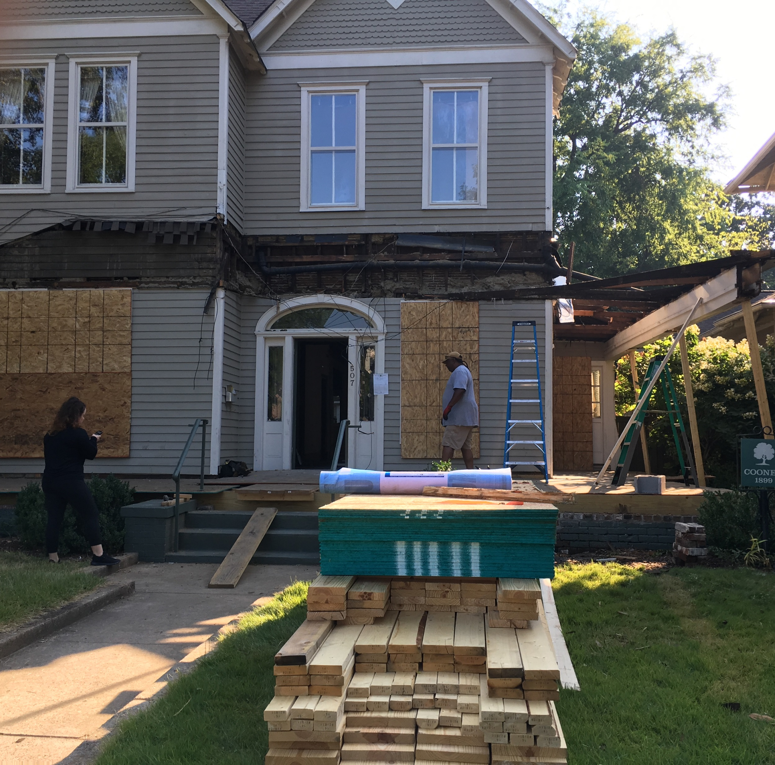
Certificate of appropriateness

Slide 9
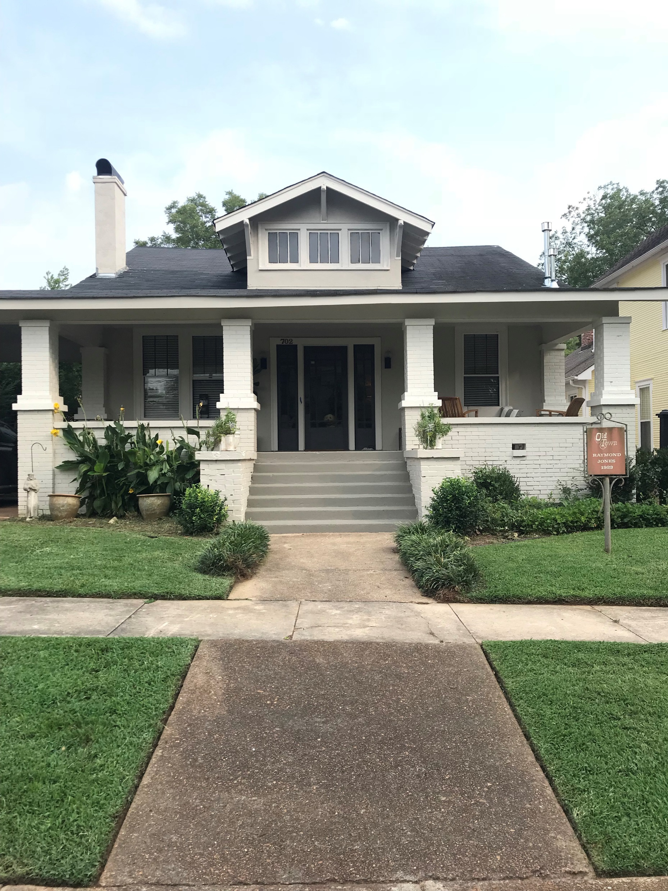
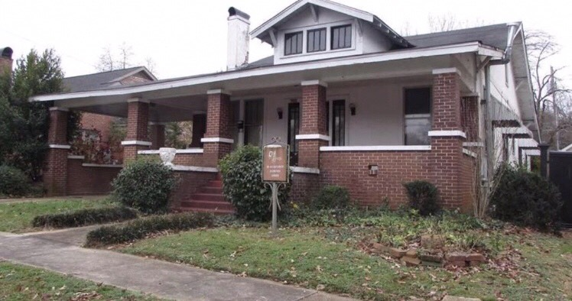
COA violations

Slide 10
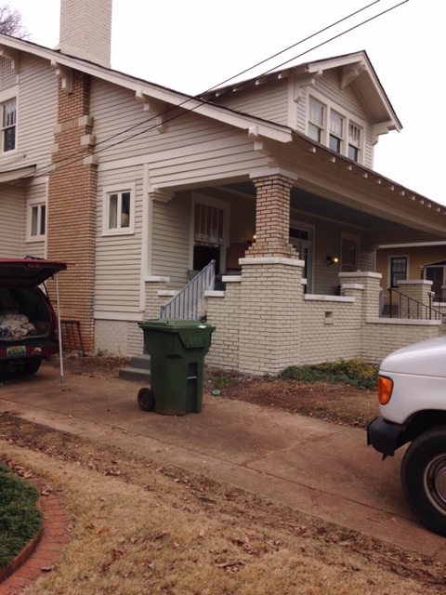
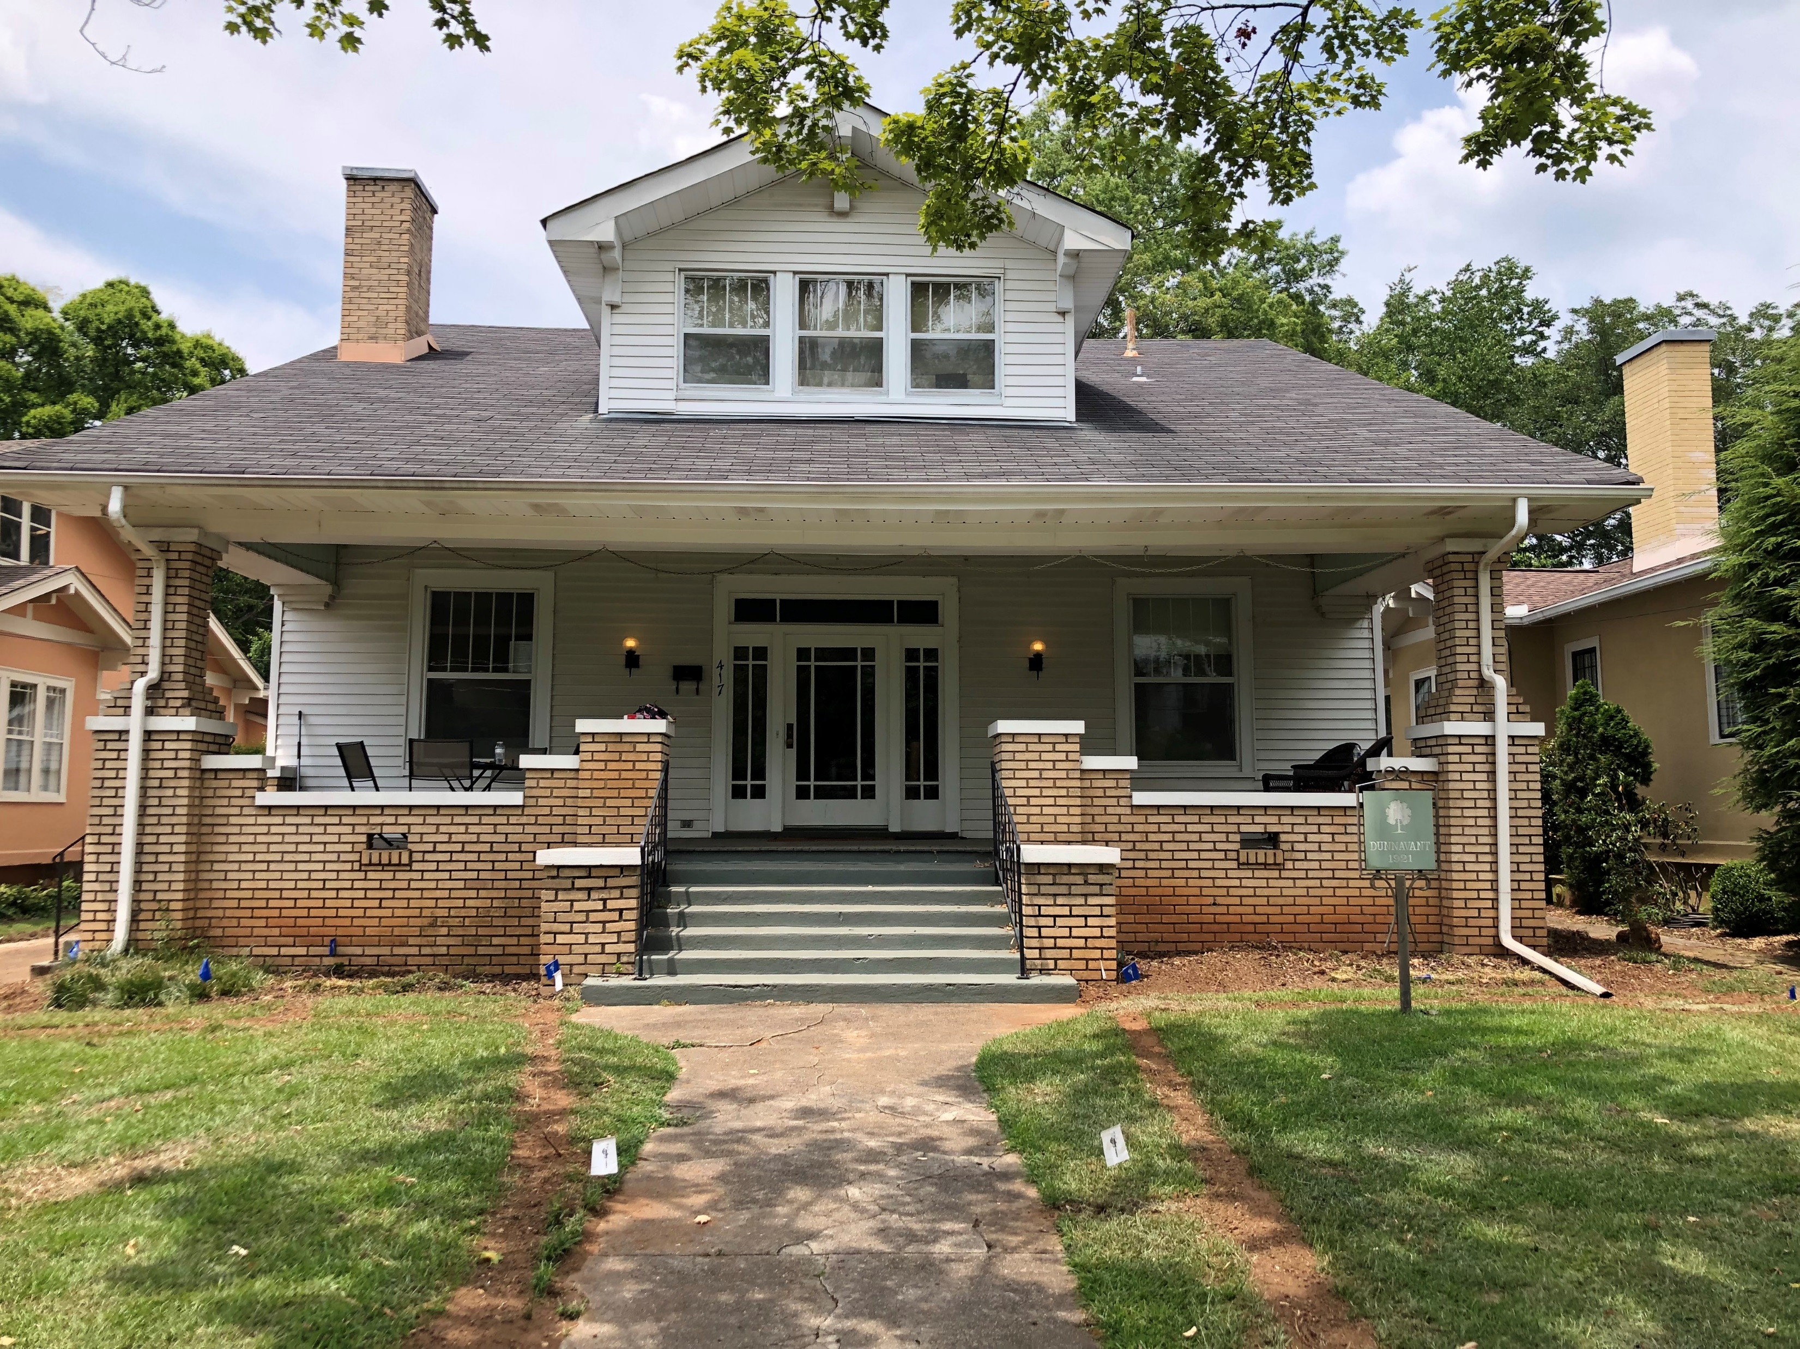

Slide 11
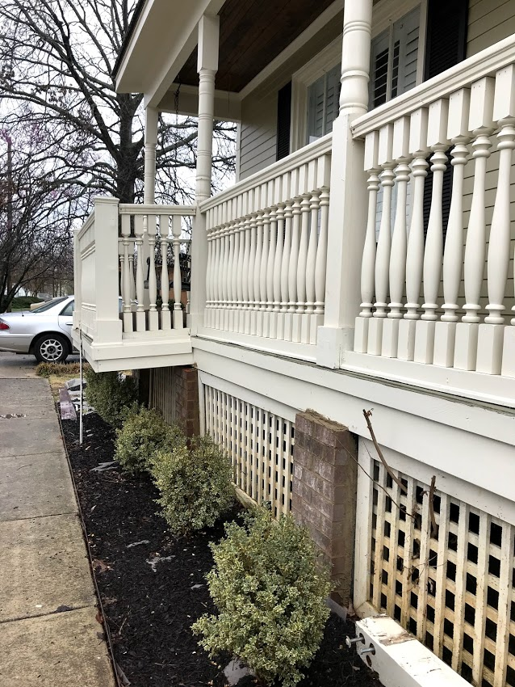
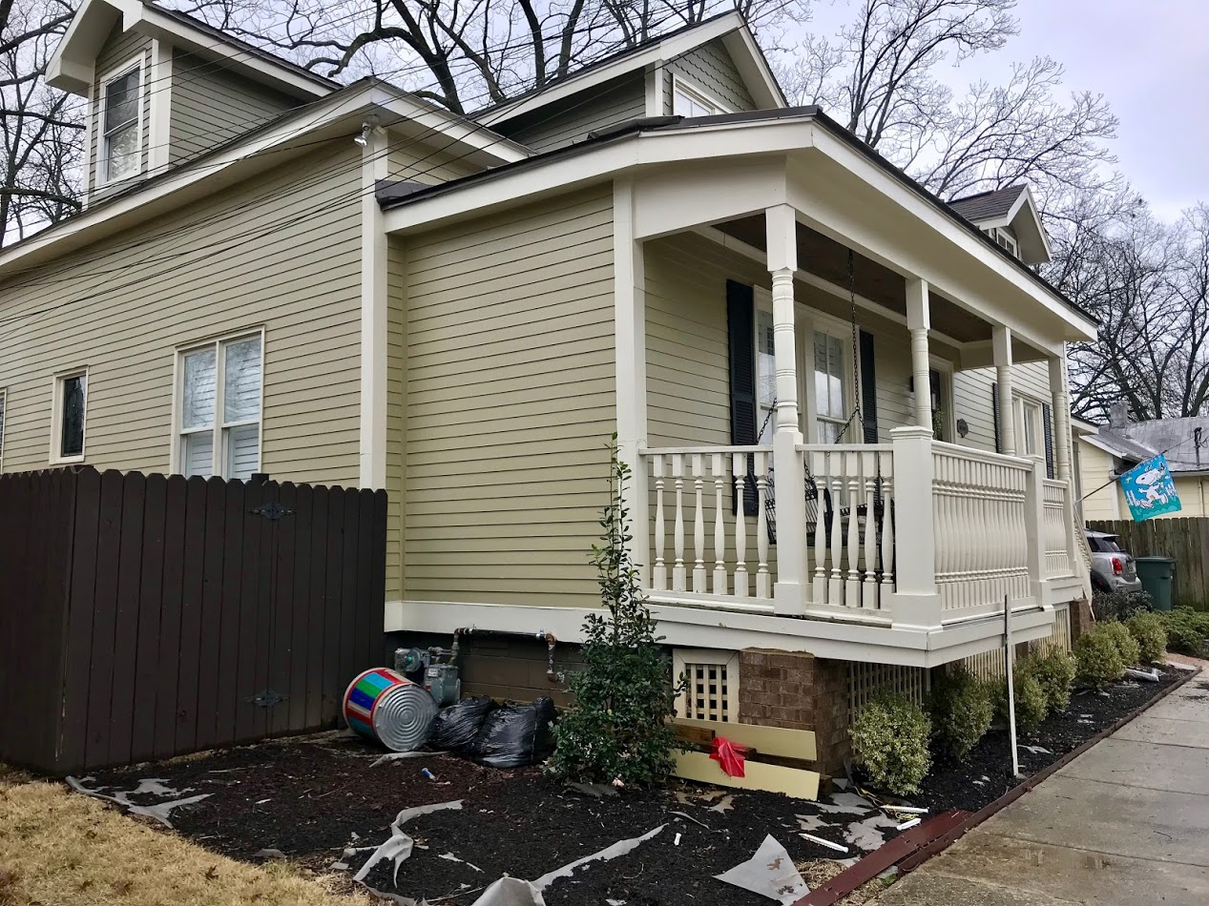

Slide 12
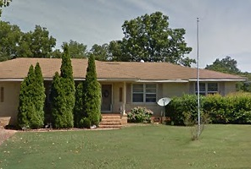
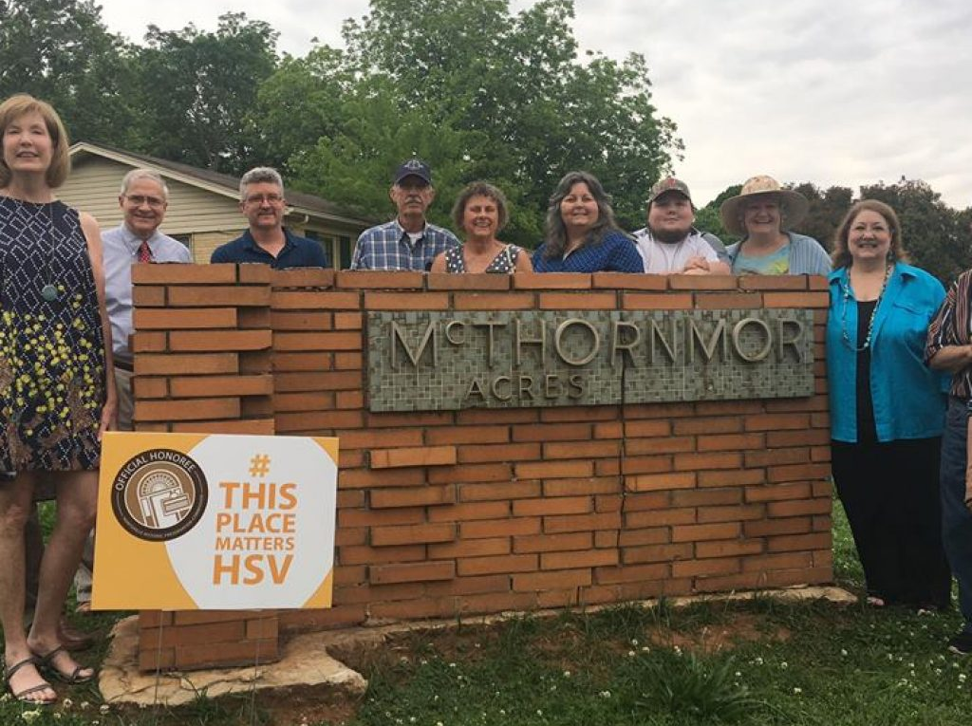
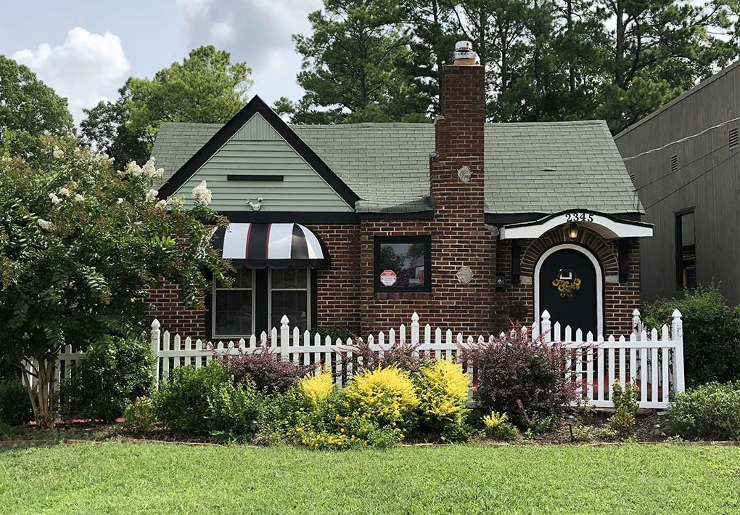
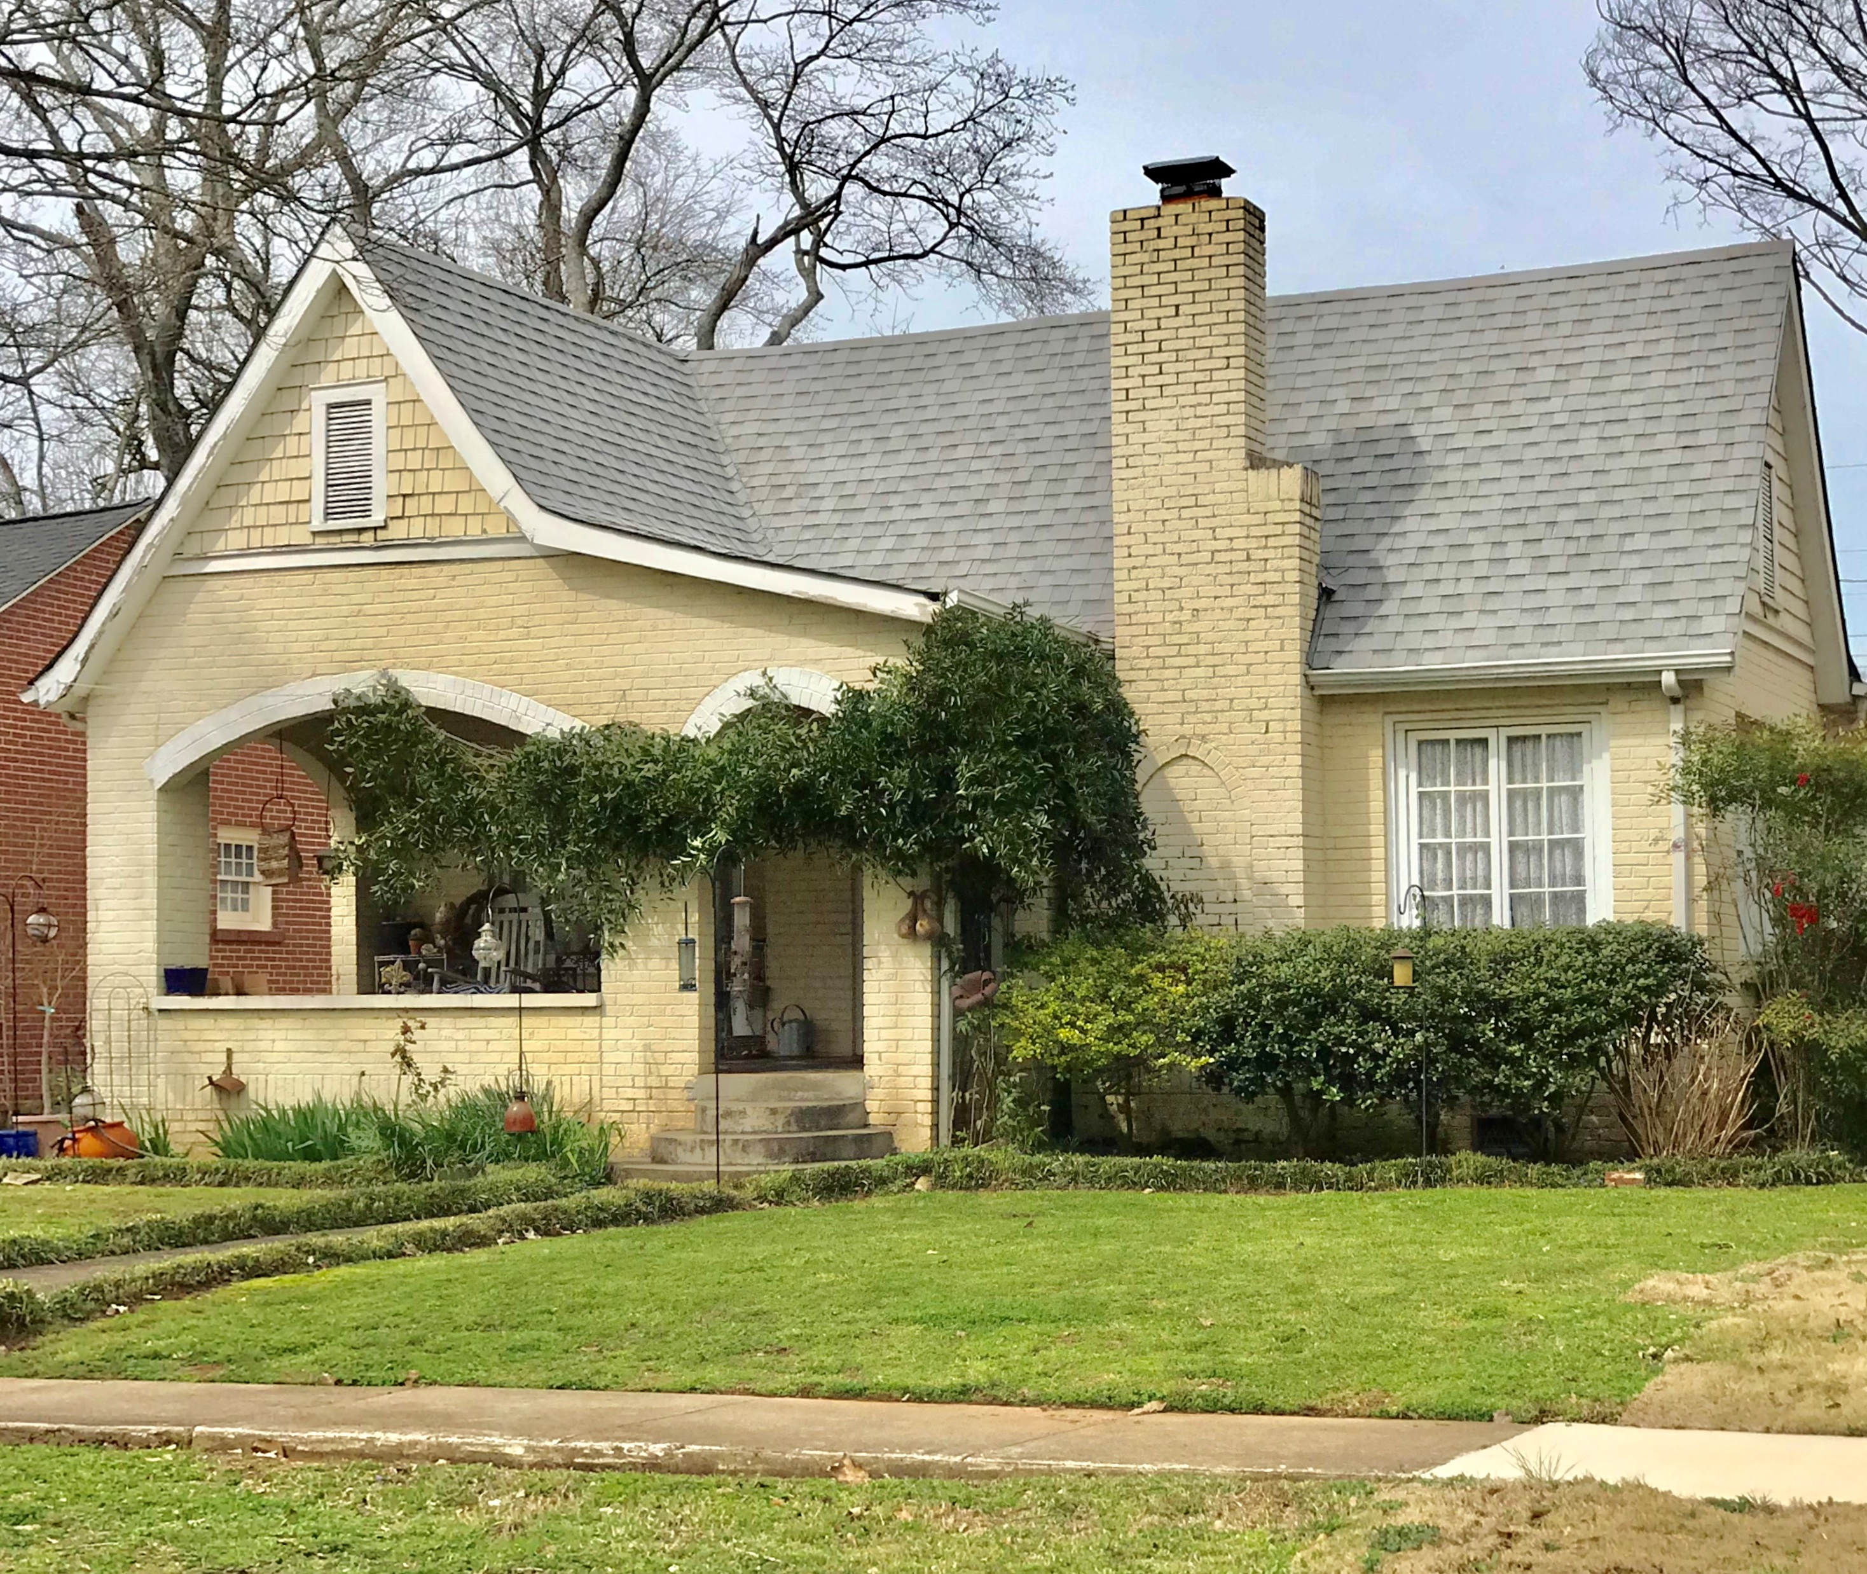
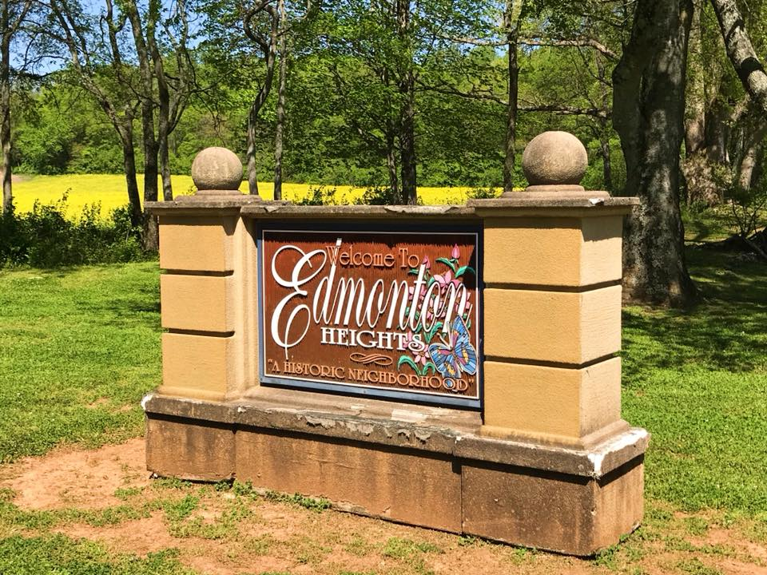
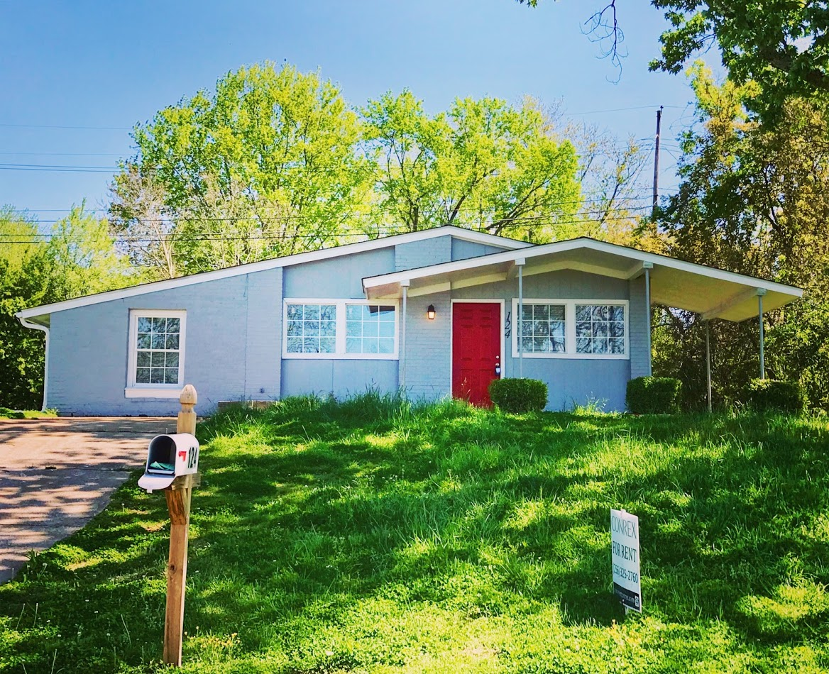
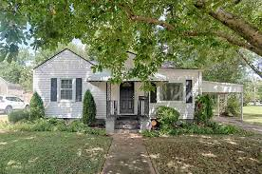
Managing CLG Grants

Slide 13
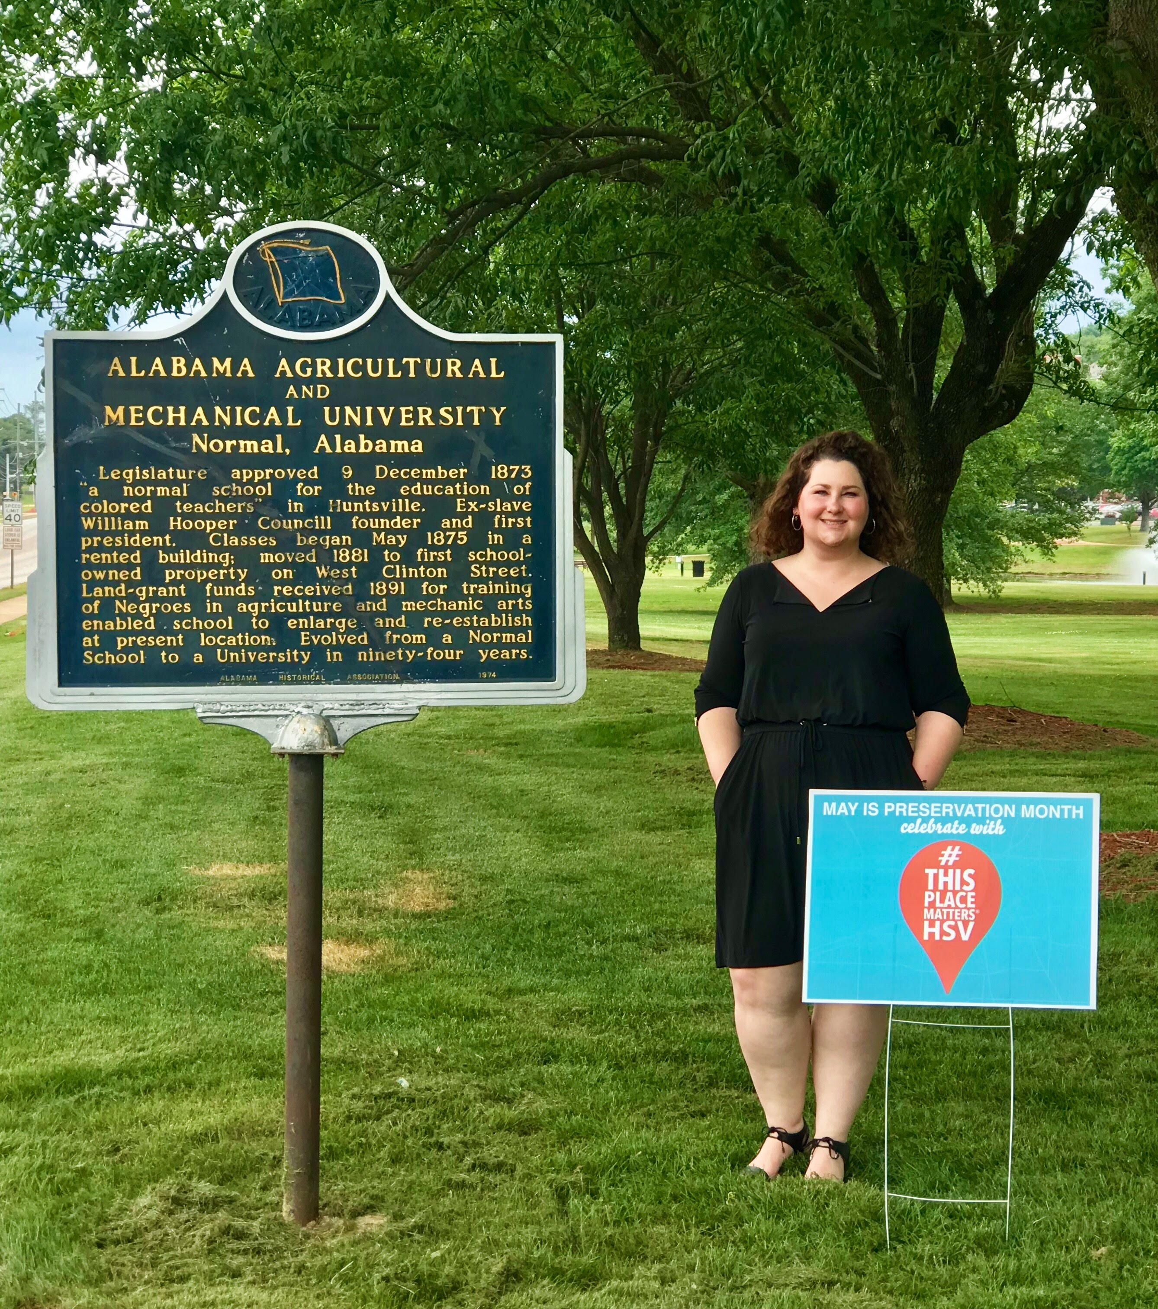
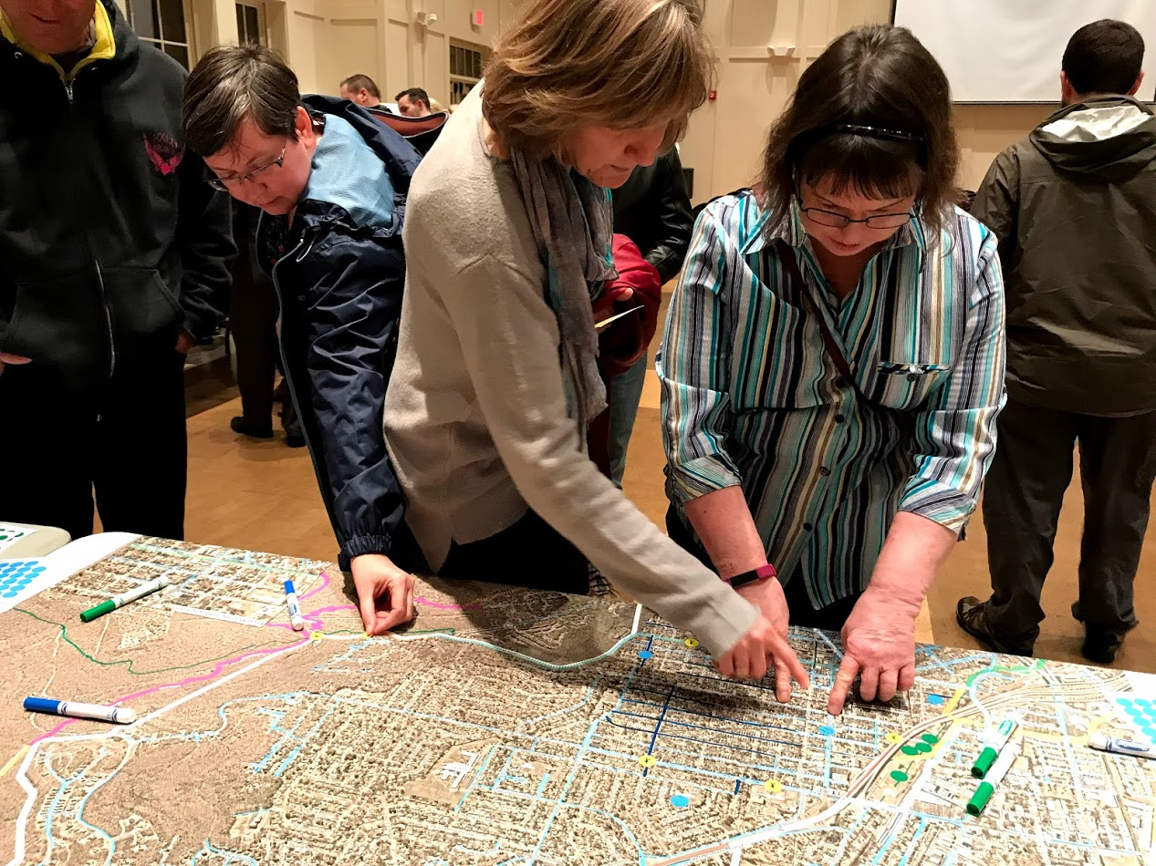
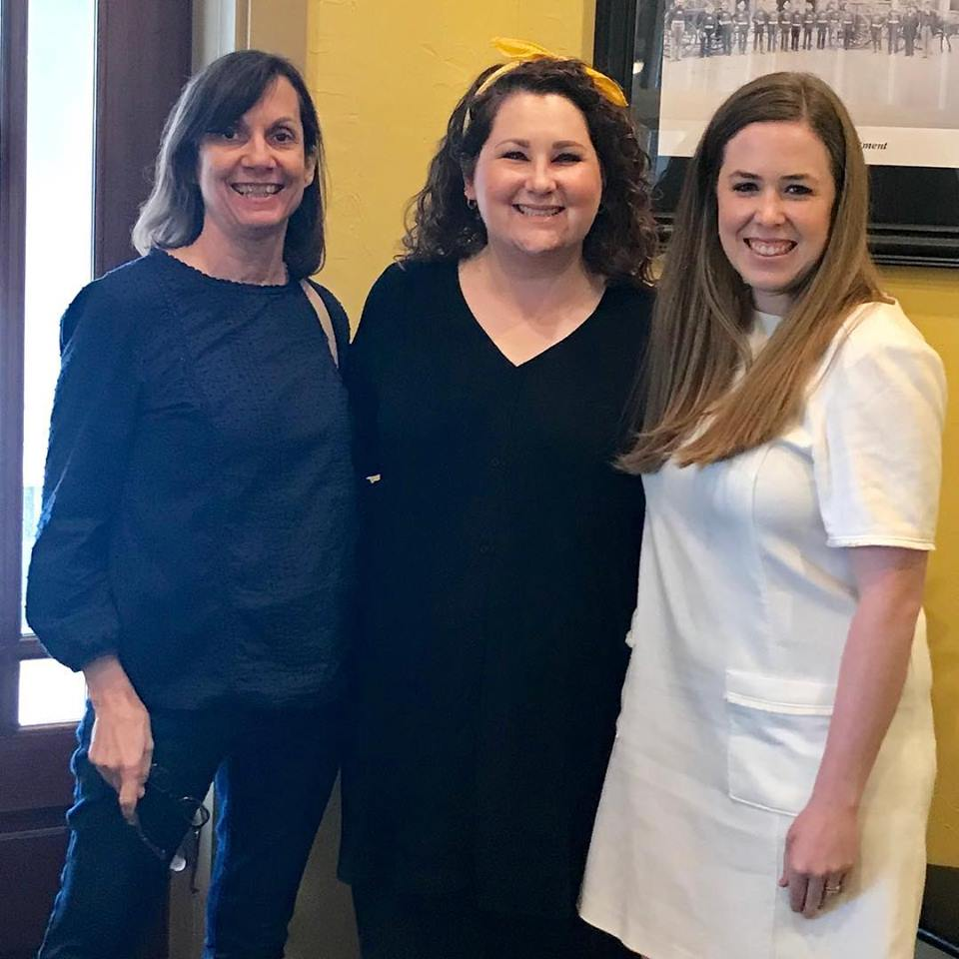
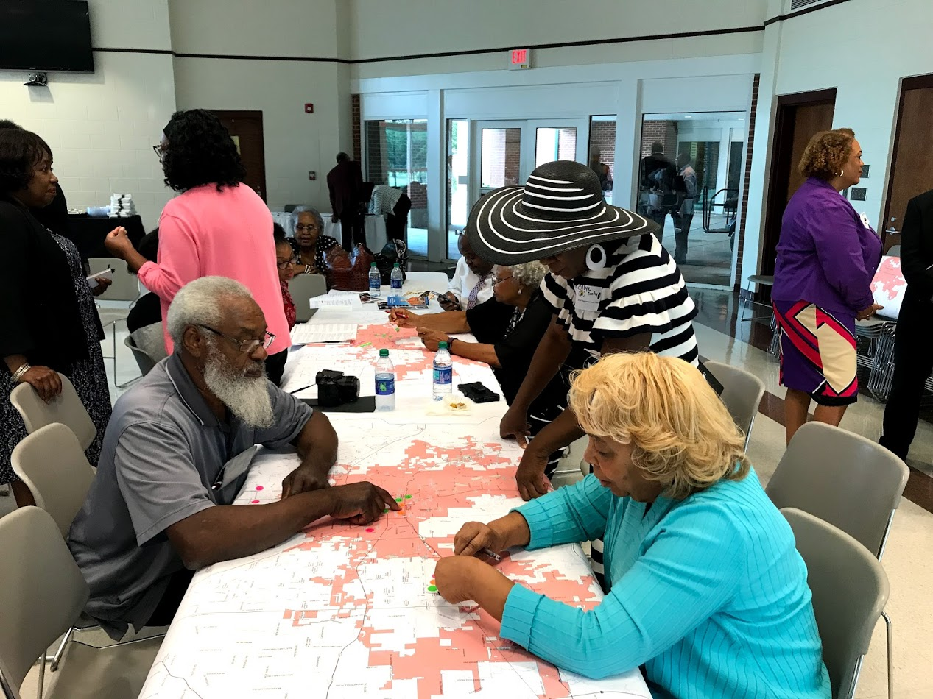
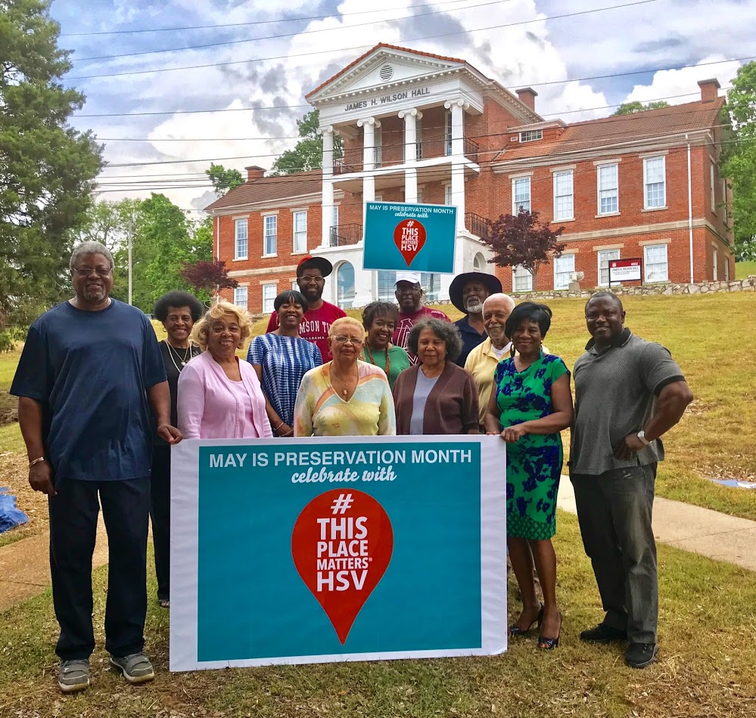
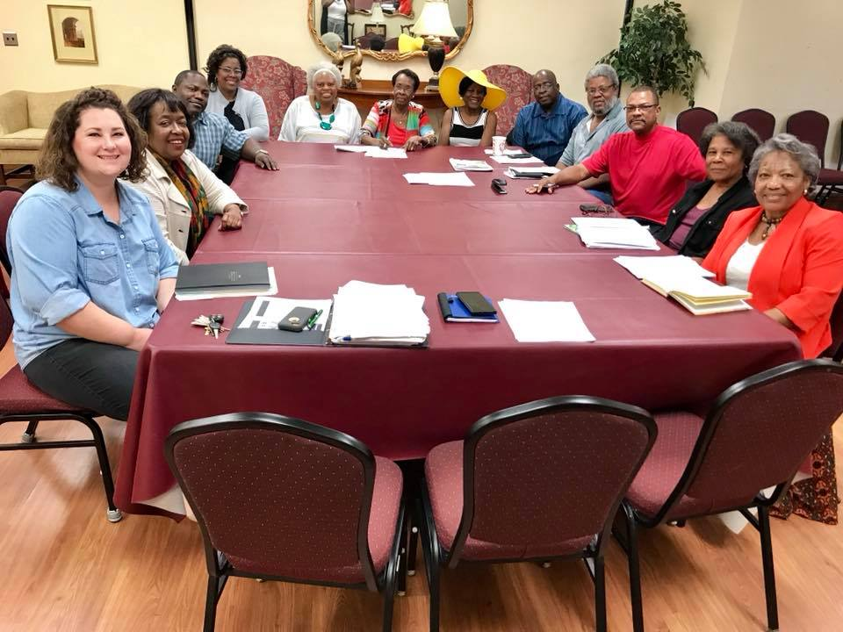
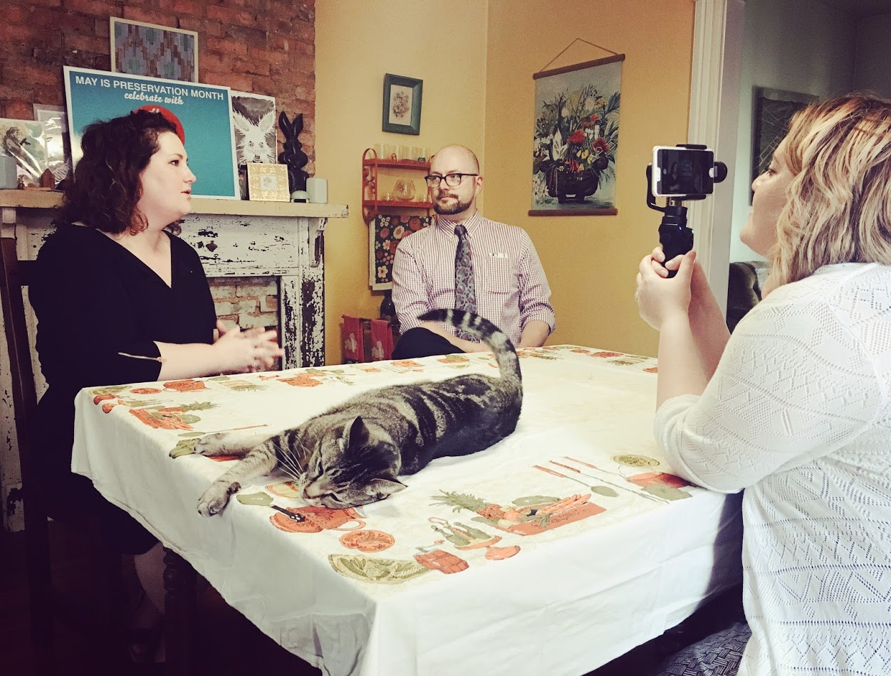
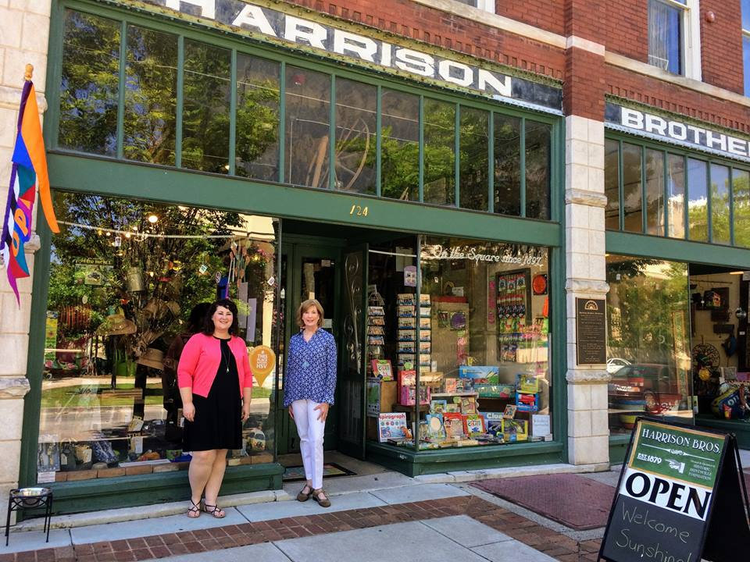
Staff Role within the Community

Slide 14
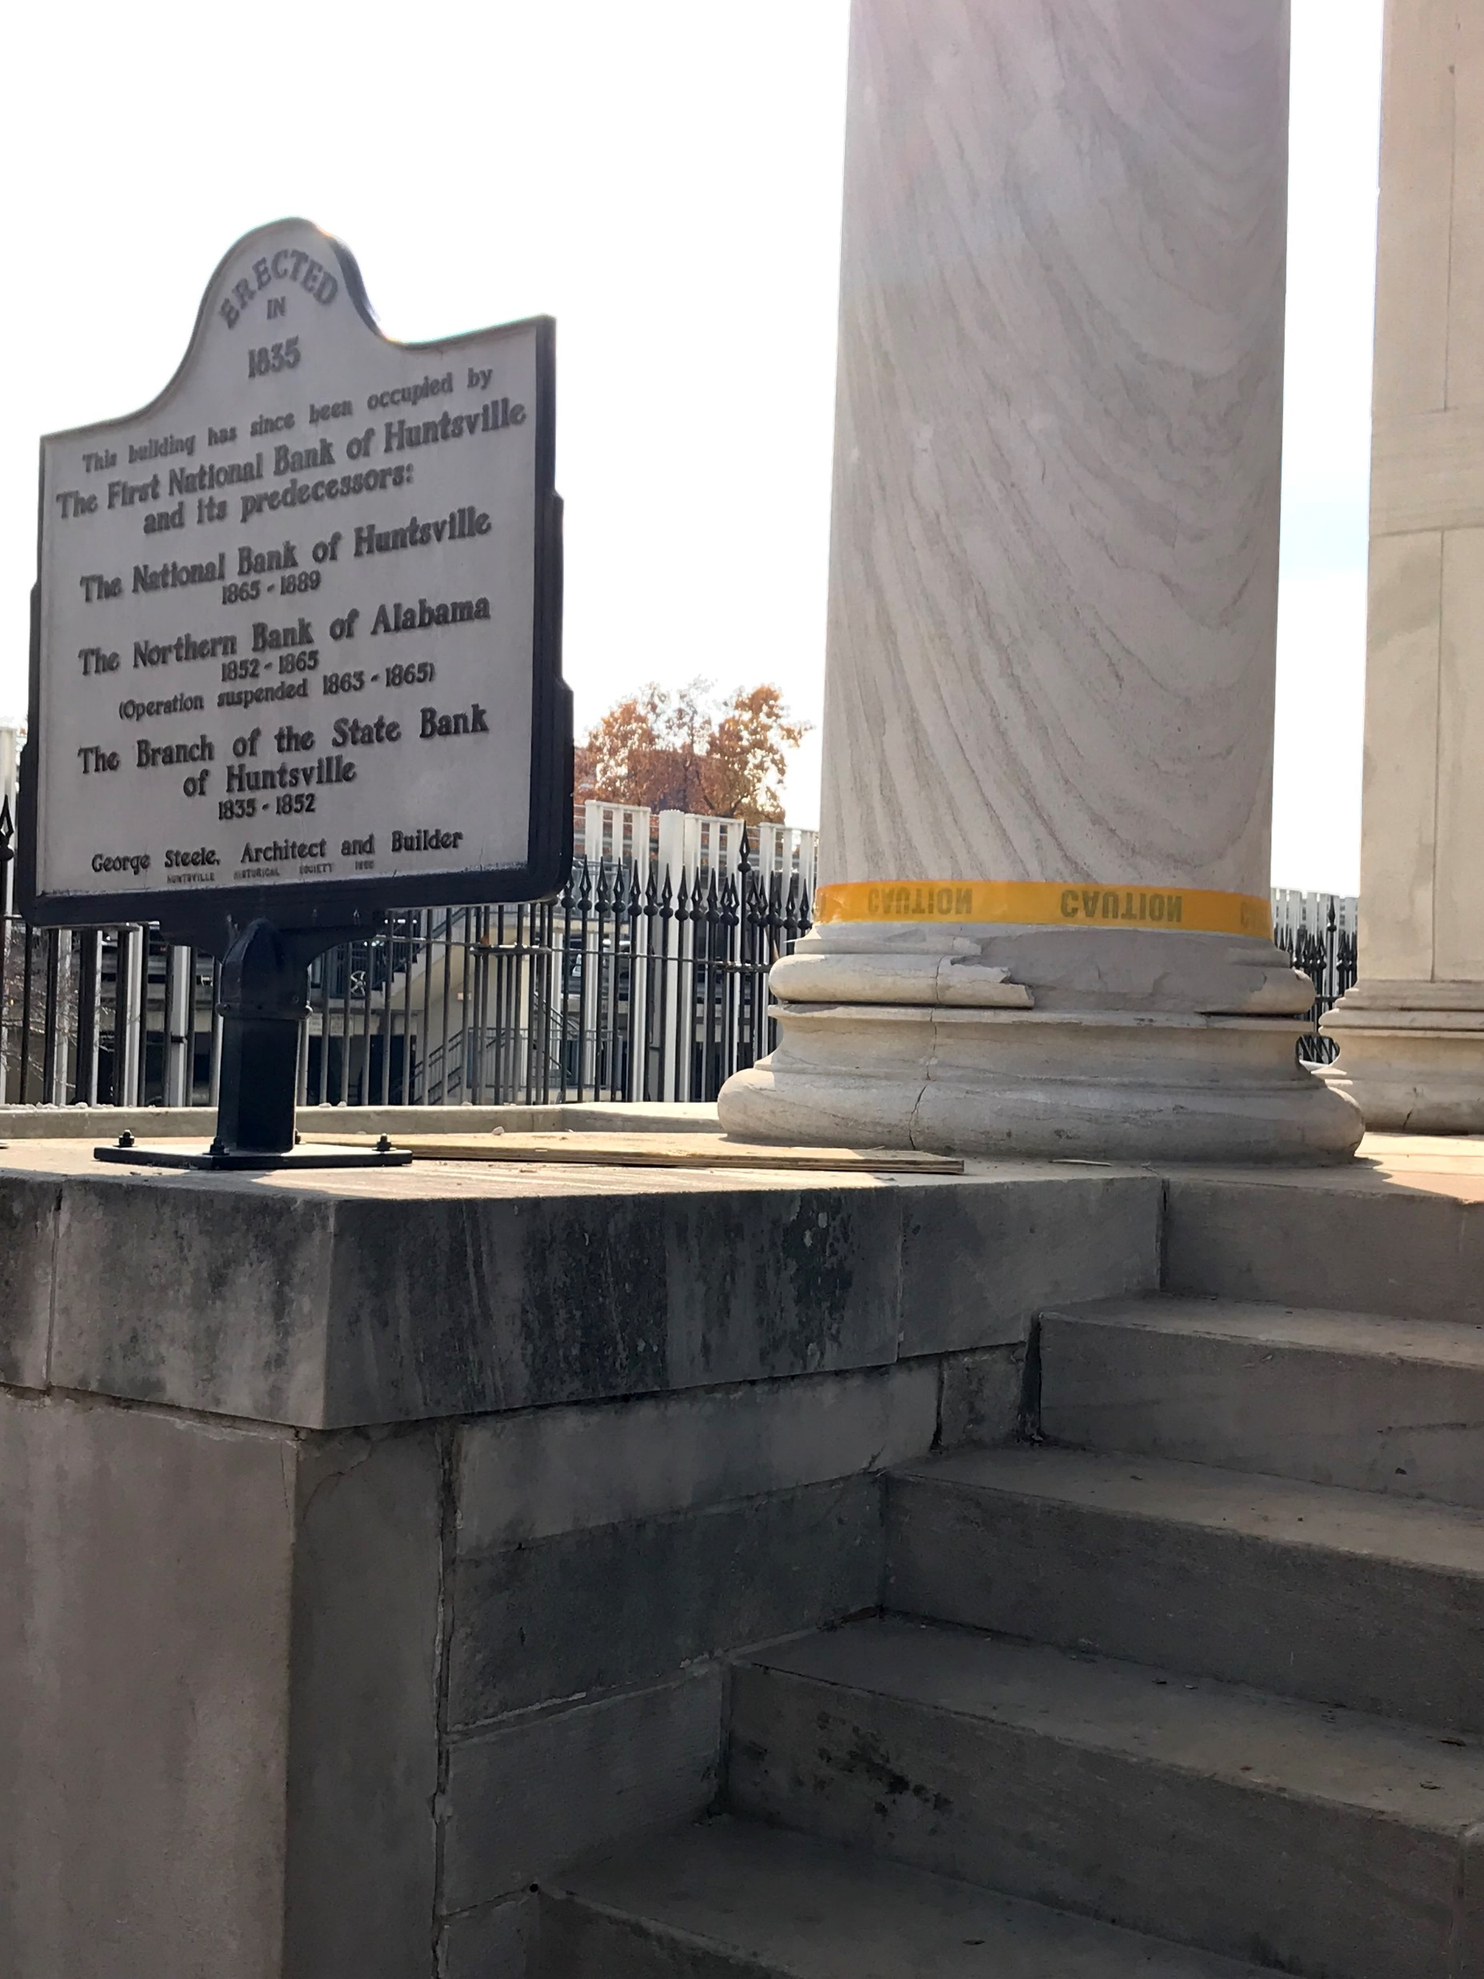
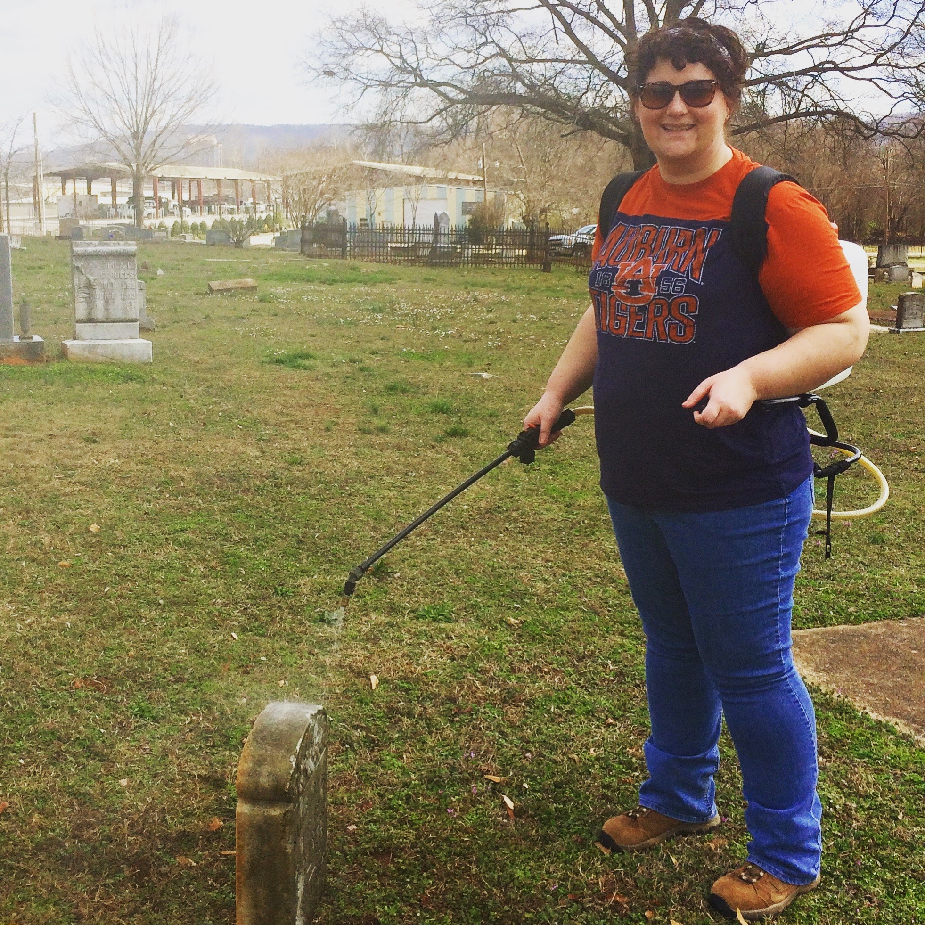
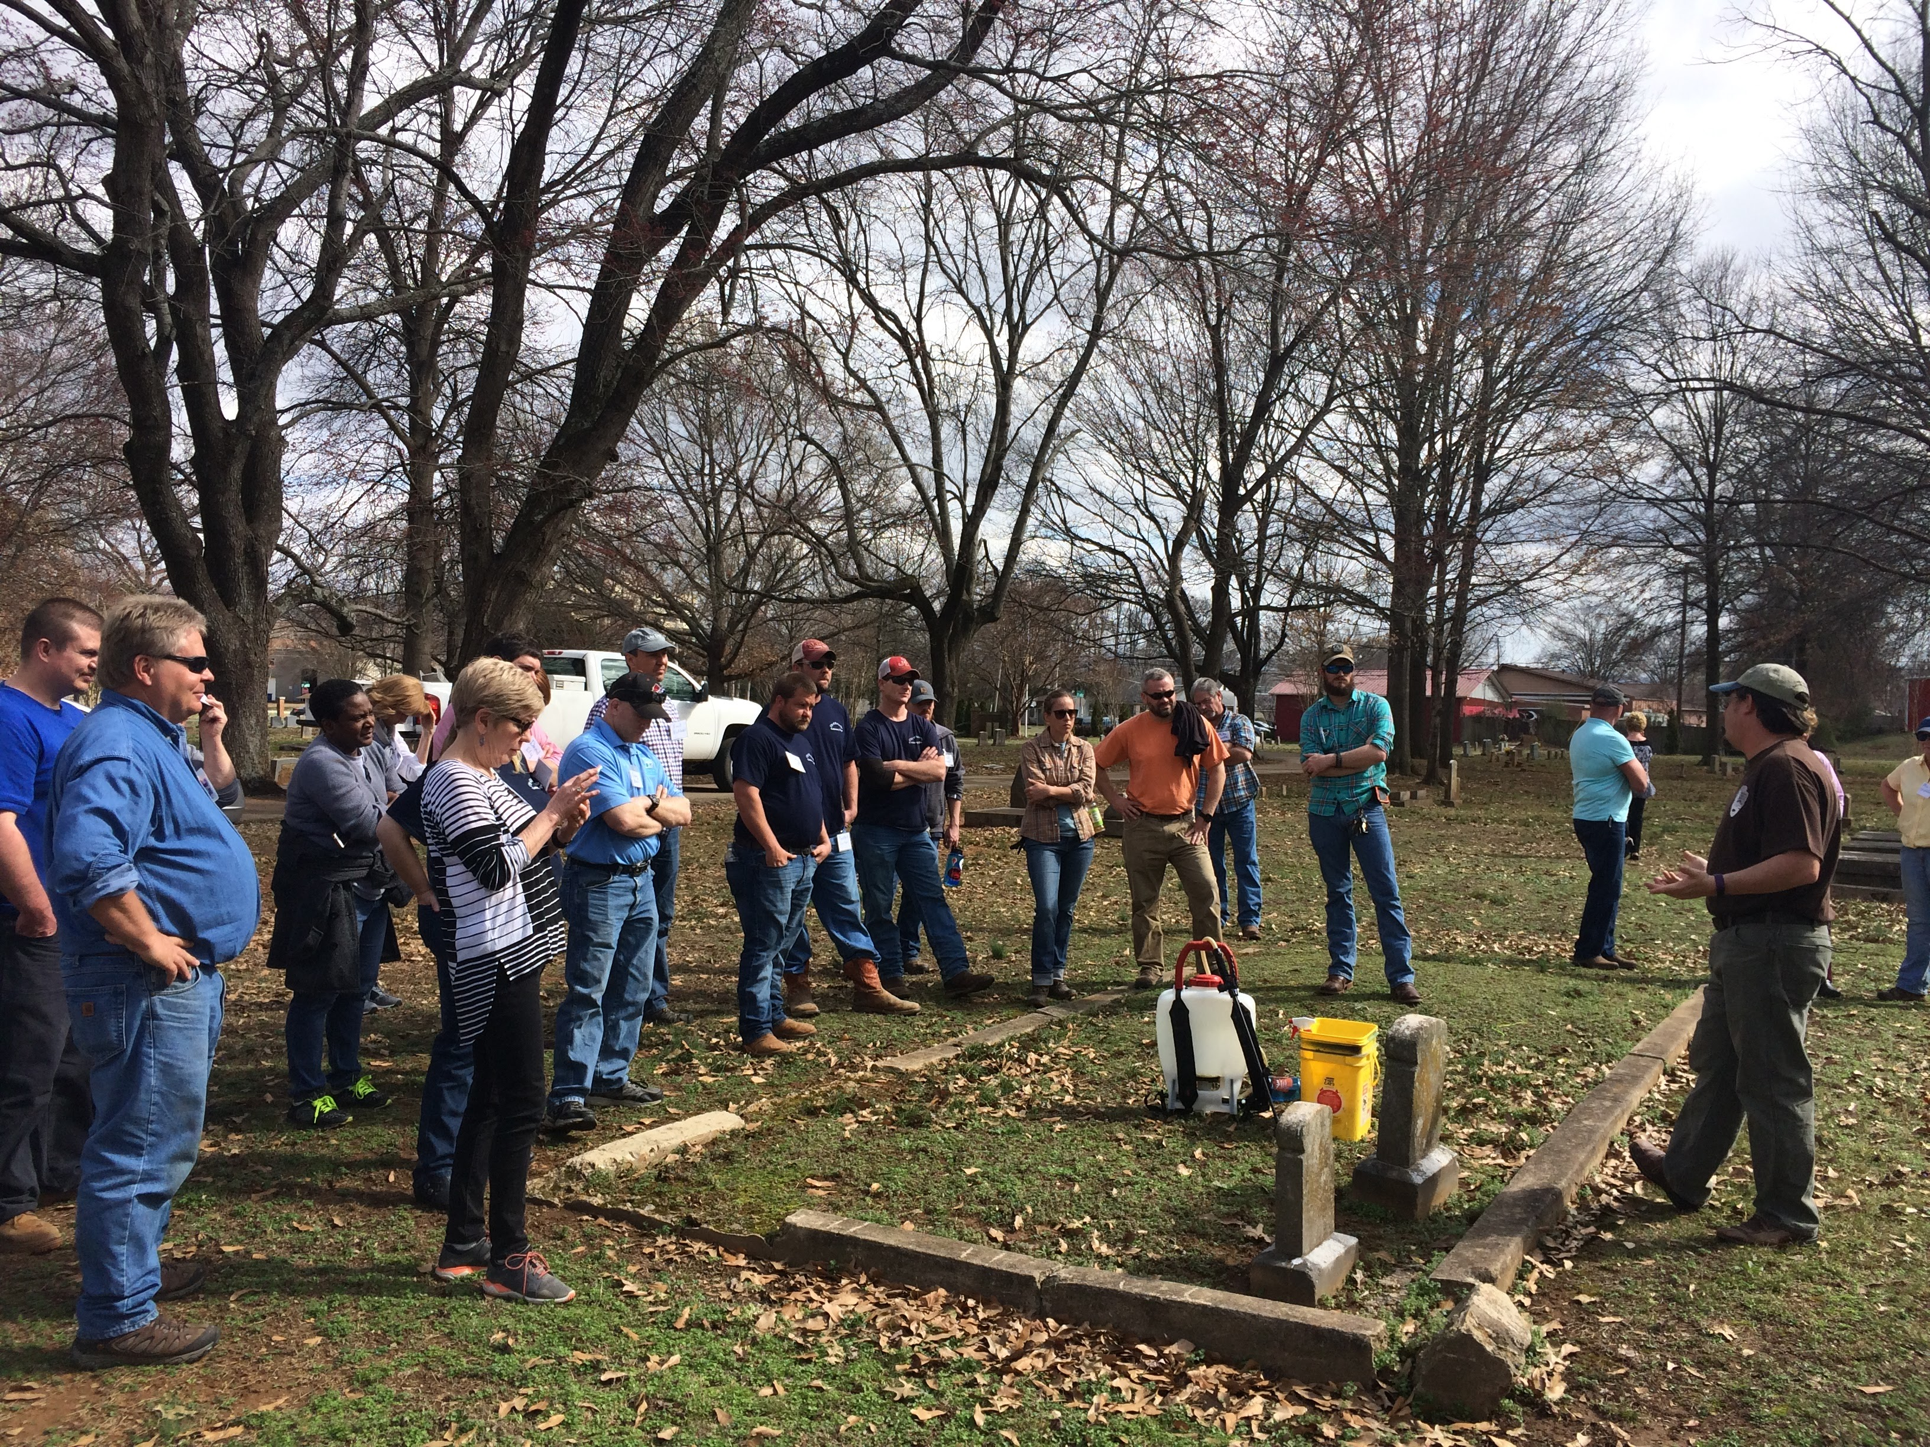
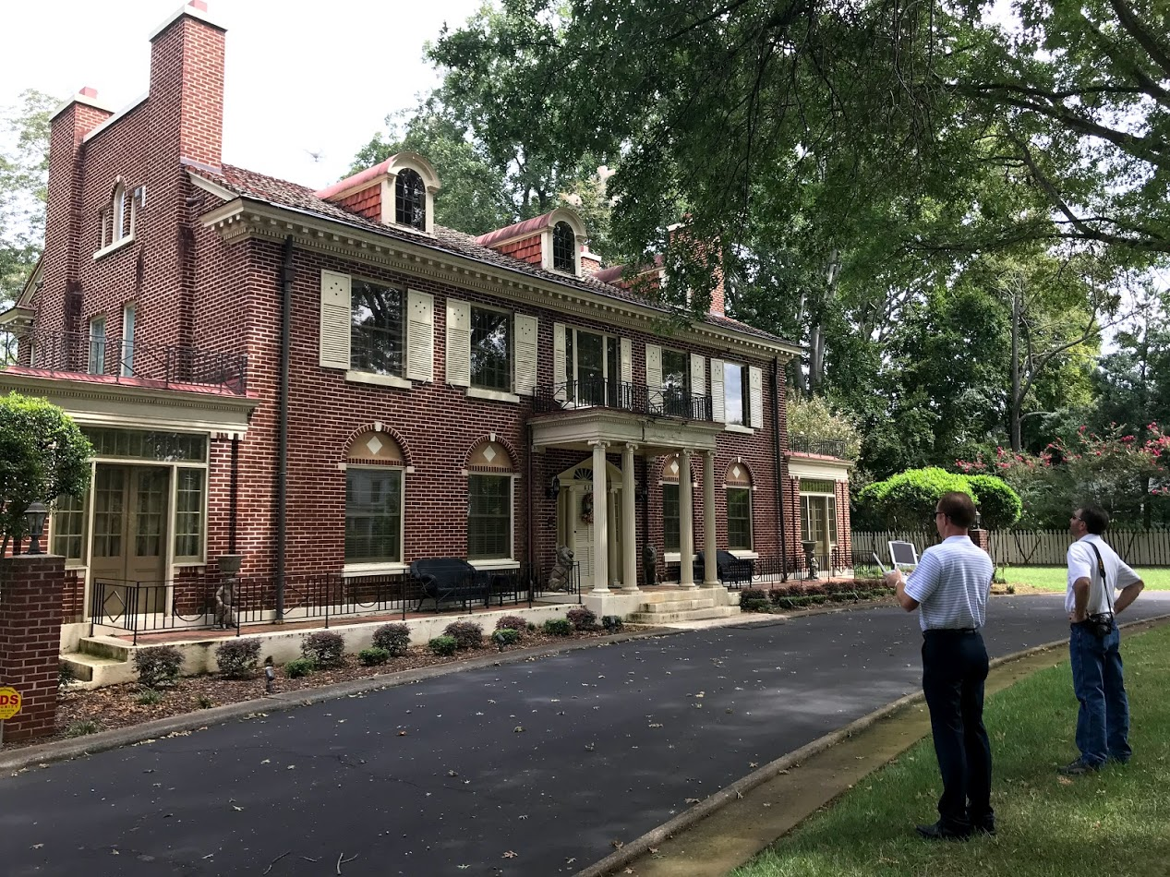
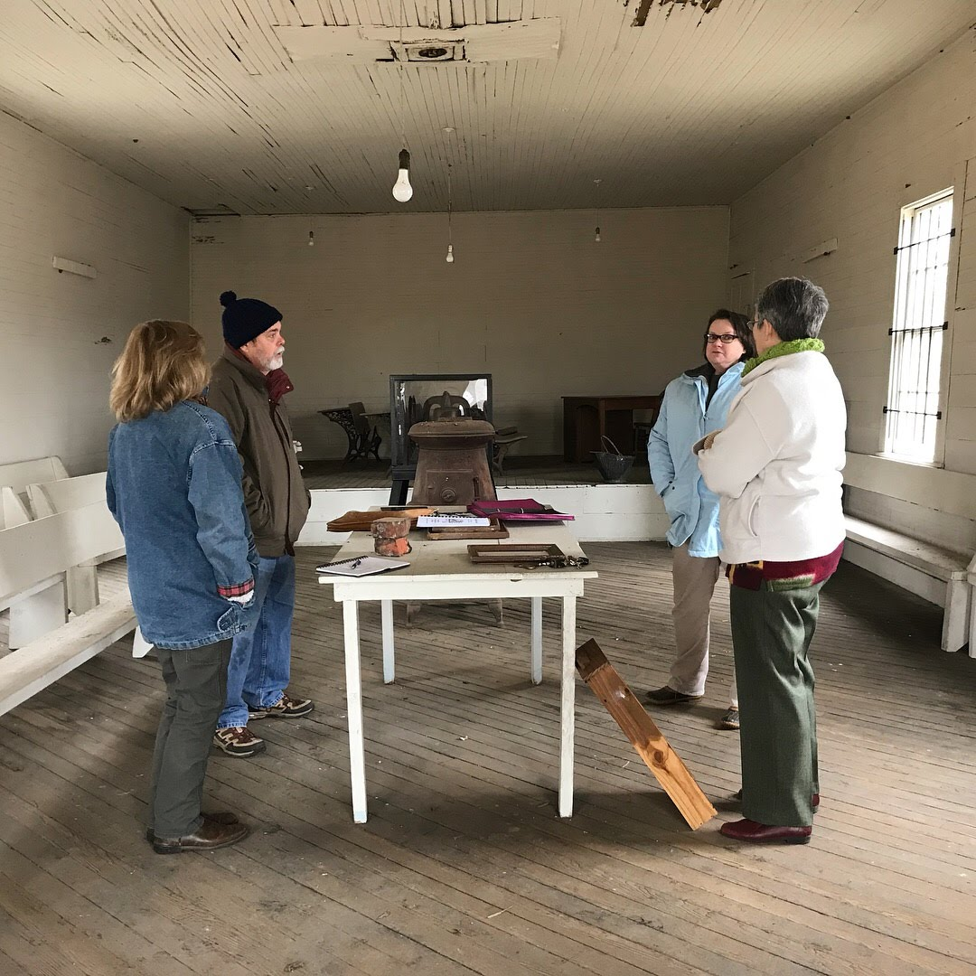
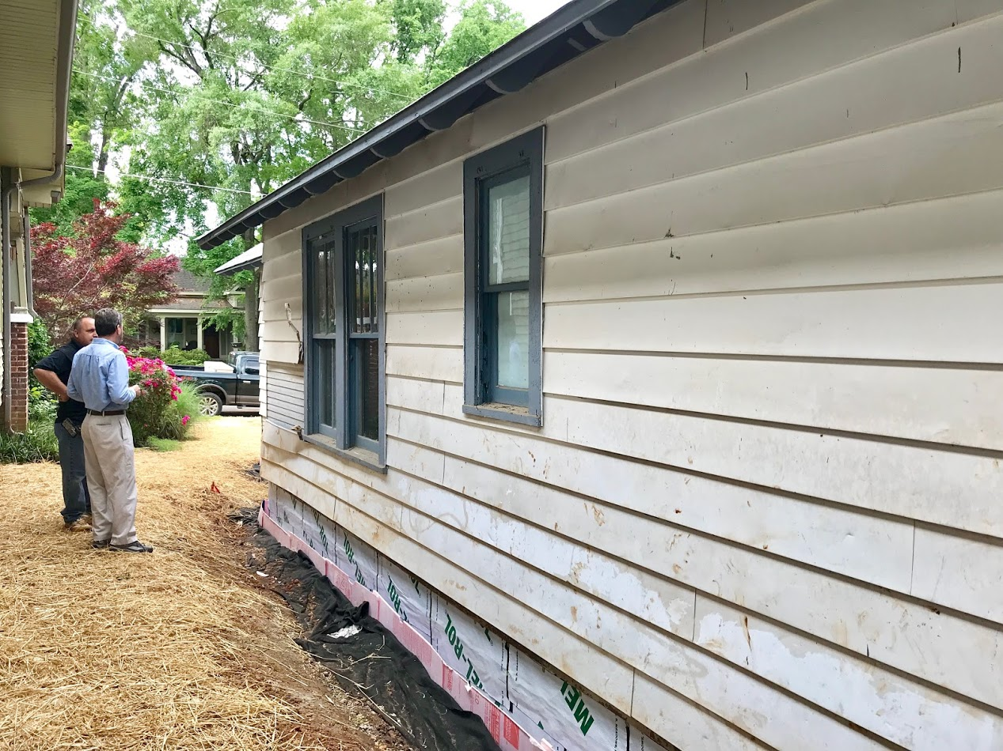
Technical Assistance to The Community

Slide 15
www.huntsvilleal.gov/preservation
Katie Stamps
katherine.stamps@huntsvilleal.gov
(256)650-4779

